Slide 1
Weather-triggered Wireless Telemetry System
Senior Design May’25 Team 18
Alex Chambers, Alexander Christie, Adam Fields, Aidan Gull, Colin Kempf, Nisha Raj
Client: Daji Qiao
Advisor: Sarath Babu
Notes:
Hi my name is … and I’m Adam Fields and our project is the weather-triggered wireless telemetry system.

Slide 2
Client Information
ARA: advanced wireless research platform covering Iowa State University, Ames and surrounding rural areas
ARA deployments span a 60km diameter
Serves as a wireless lab enabling research into rural focused technologies
Research teams worldwide utilize ARA testbed to conduct network experiments
ARA infrastructure includes a wide variety of wireless technologies including microwave, satellite and low-UHF mMIMO
Bandwidth ranges from a few Mbps to hundreds of Gbps
Notes:
ARA is an advanced wireless research platform that covers Ames and the surrounding area in a 60km diameter. ARA serves as a wireless lab enabling research into rural focused technologies. Research teams worldwide utilize ARA’s framework to conduct network experiments. ARA Infrastructure includes a variety of wireless technologies with bandwidths ranging from a few Mbps to hundreds of Gbps.

Slide 3
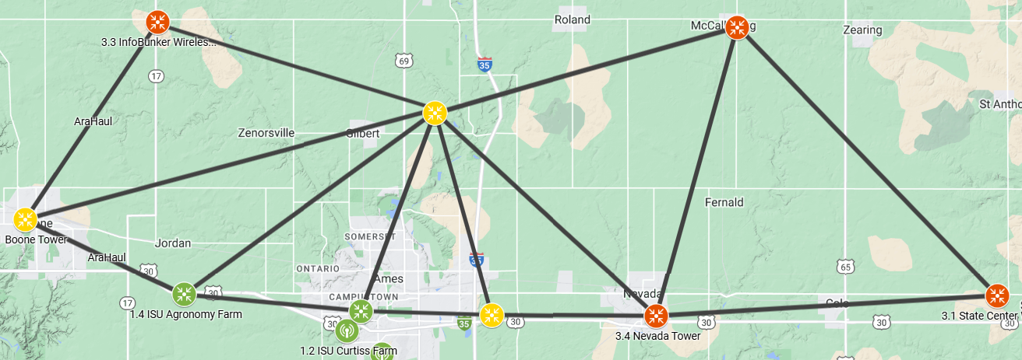
ARA Infrastructure
Notes:
ARA is currently working on expanding their infrastructure. Here is the map of the current plan of their infrastructure. At this point, the red points are planned sites for ARA weather stations and other wireless technologies. Other sites (marked with green and yellow) are already installed and frequently utilized.

Slide 4
Project Plan & Management

Slide 5
Project Overview
Purpose
Analysis of ARA framework performance during weather events
Generate data sets to enable researchers to study how weather events affects wireless data
Goal
Develop a weather-triggered telemetry system that measures the performance of wireless technologies deployed on ARA before, during, and after weather events of interest
Tasks
Collect network data during a variety of weather events
Analyze weather events effect on wireless signal data
Store collected data so users can query formatted data sets

Slide 6
Approach
Create a script utilizing multiple weather forecasting APIs to predict weather events
Script will continuously predict when a weather event will begin and end
Recognize weather events and set a lead-in time to trigger data collection
Once weather events are completed continue collecting data until lead-out time collection has been completed
Data sets collected will be formatted in a hierarchical ZIP file structure
Create a user-friendly interactive UI so researchers can query for this data to analyze

Slide 7
User Needs
Internal and external users that have the same needs
Researchers want to collect weather event data in order to store and publish this data
Researchers need weather data to analyze how ARA equipment is affected by weather events
Researchers need to know when weather events occurred to analyze how weather events affected their tests on the ARA framework
Researchers need an easy way to query specific weather event data sets

Slide 8
Functional Requirements
The software shall gather and store data during specified weather conditions
The software shall use multiple weather forecasting APIs to predict when a weather event will occur.
The software shall trigger data collection when weather event is detected during the 30 minute lead-in data collection time
The software shall have lead-in and lead-out time where data is being collected 30 minutes before and after the weather event
The software shall aim to reach a 70+% accuracy for gathering data
The software shall incorporate a UI that allows users to query specific weather events
When data collection for a weather event is complete the software shall send data to be processed and stored in a ZIP file hierarchy

Slide 9
Non-Functional Requirements
The software shall use the ARA framework to collect and store weather and wireless signal data.
The software will run on the server provided by the ARA framework.
The software shall utilize the ARA disdrometers and weather stations when collecting live weather data.
The software shall utilize data visualization tools such as graphs and histograms to visualize relations.
The UI shall be accessible and intuitive to query data for users.
The UI shall execute queries in a timely manner.

Slide 10
Market Research - APIs
Researched several possible weather forecasting APIs that could be potentially used to gather our prediction metrics
6 APIs stood out to us as potentially meeting our needs:
Tomorrow Weather
OpenWeatherMap
Open-Meteo
WeatherBit
National Weather Service
AccuWeather
Through our research we came to the conclusion that OpenWeatherMap, WeatherBit, and AccuWeather had issues that would interfere with our project needs
Tomorrow Weather, Open-Meteo, and National Weather Service all looked promising with what data we could acquire using their APIs

Slide 11
API Research Results
API | Issues
OpenWeatherMap | Requires a subscription Charges for making over 1000 API calls a day
WeatherBit | Requires a subscription Only 50 API calls per day No data points for wind speed
AccuWeather | Needs an account Only 50 API calls per day for free account Free accounts only receive one API key

Slide 12
API Research Results
API | Features
Tomorrow Weather | Free Localized weather data Project integration well-documented Many applicable data points
National Weather Service | Free & open source JSON formatting Caches result of requests
Open-Meteo | No API key 10,000 requests per day Responds with data points chart to be plotted

Slide 13
Constraints & Considerations
Storage Considerations
Consider storage constraints of weather stations and wireless radios
User Knowledge
Understanding of SQL query language
Executing and creating queries to find needed information
Understanding of data visualization tools
User Interface Requirements
Intuitive interface for users
Simple navigation for new users on first attempt

Slide 14
Project Risks & Mitigation
Risk | Mitigation
External API becomes unavailable | Utilize multiple different APIs
Unable to collect weather data from ARA framework | Work with ARA administrators to resolve data collection issue
Server running our script becomes unavailable | We will always have backups of our code; can request an additional server and have scripts running in parallel
Data corrupted or input not as expected | In data processing script create a check for corrupted of incorrectly formatted data
UI Query SQL Injection | Sanitize and validate user query input
Causing hardware malfunctions | Ensure program is tested before merging with ARA testbed equipment

Slide 15
System Design

Slide 16
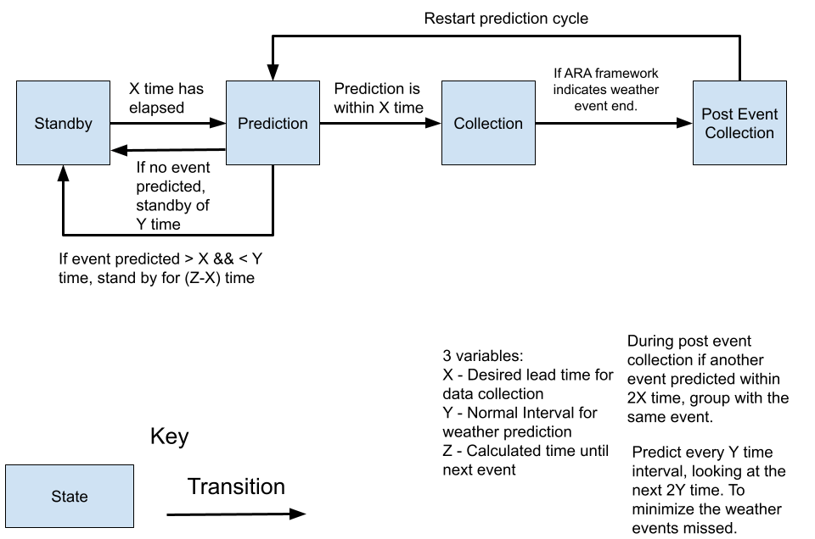
State Diagram
Standby: Passive state of software
Prediction: Software uses weather APIs to predict future events
Collection: Software state when weather data from ARA framework received for lead-in time before weather event
Post Event Collection: Gathers data for lead-out time, stores collected data

Slide 17
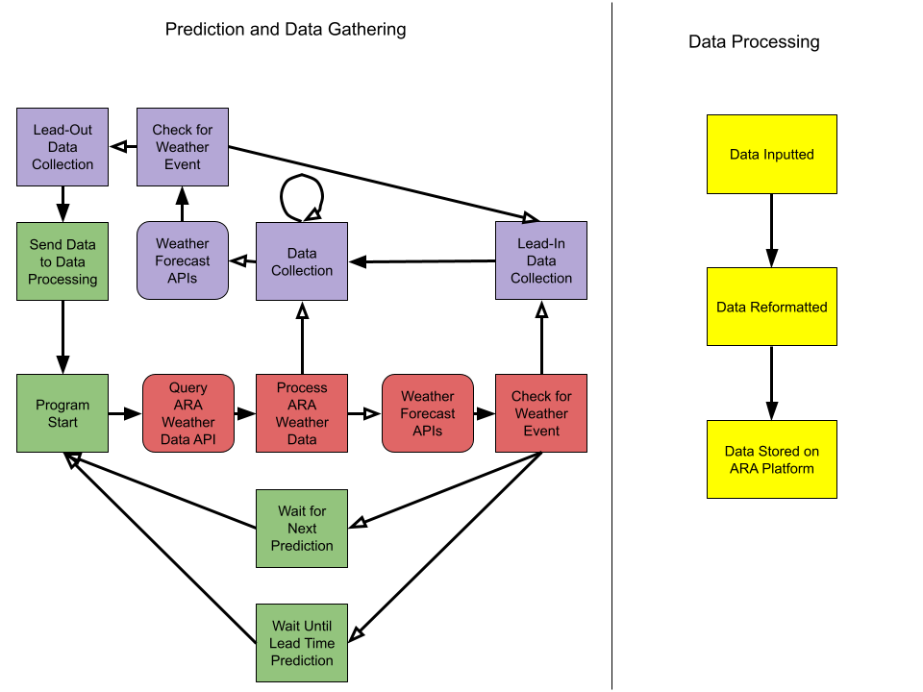
Component Breakdown
Consolidate Weather Data: Handles predicting through API forecast data querying and validation
Consume & Record Active Weather Data: Querying ARA network to record live weather event data
Program Overhead: Gatekeeper for starting predictions and consolidating weather data block
Data Processing: Handles the output data and format in a queryable format along with hierarchical zip file
Notes:
Mention feedback loop for validation

Slide 18
Initial Prototyping
Created an initial prototype script to gather forecasting data from the APIs
Collects specific weather features from the APIs:
Temperature
Wind speeds
Humidity
Wind direction
Using these features we can begin to determine which have the highest correlation to the actual weather data gathered by ARA
Collected data stored in text files
Used the collected data to create graphs showing these predicted features from APIs versus the actual weather data at that time

Slide 19
Results

Slide 20
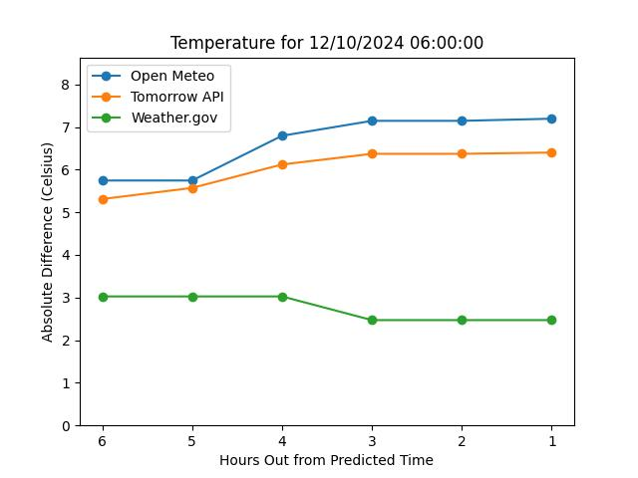
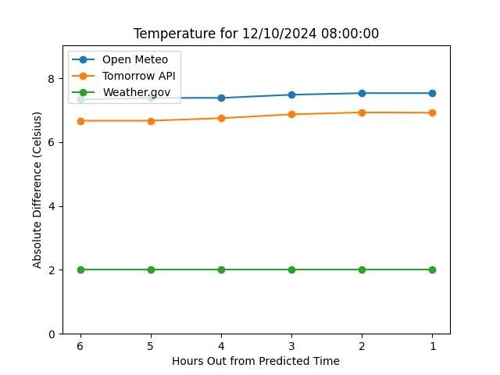
Temperature Prediction Analysis
Actual: 2.4705 Cº
Actual: 2.5597 Cº

Slide 21
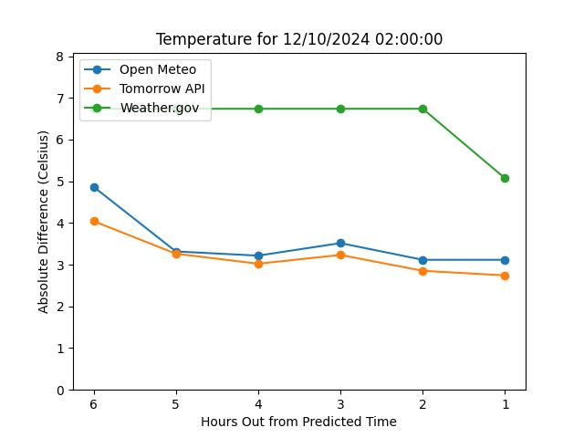
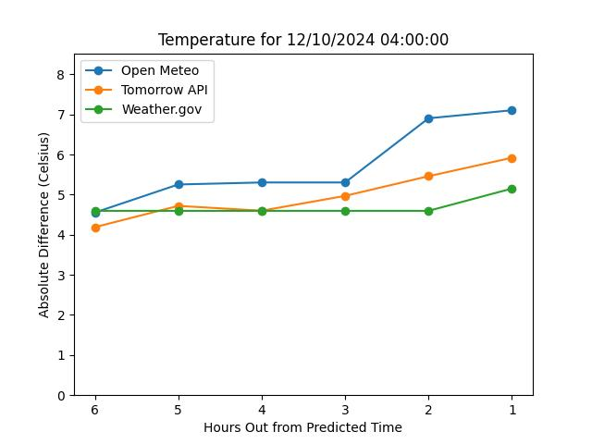
Temperature Prediction Analysis
Actual: 2.2933 Cº
Actual: 2.9284 Cº

Slide 22
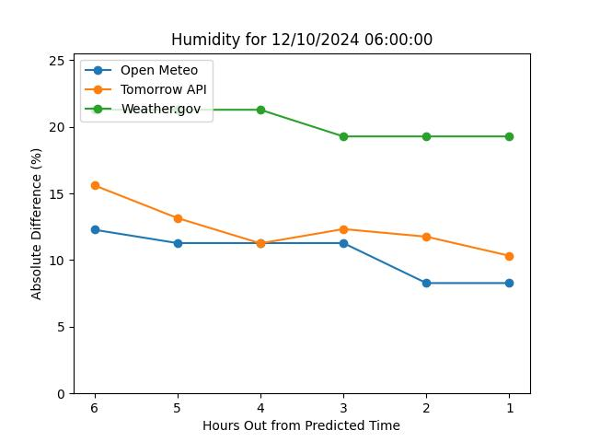
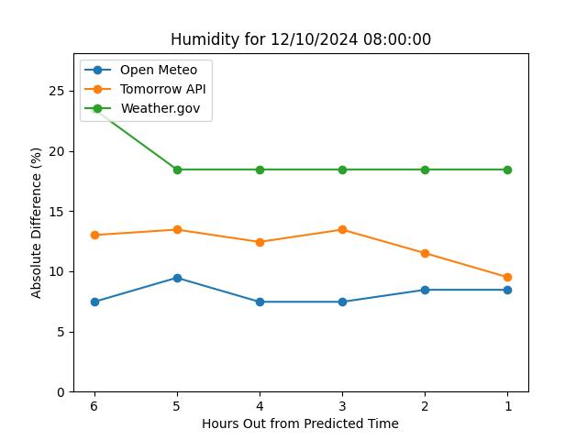
Humidity Prediction Analysis
Actual: 82.2758%
Actual: 81.4592%

Slide 23
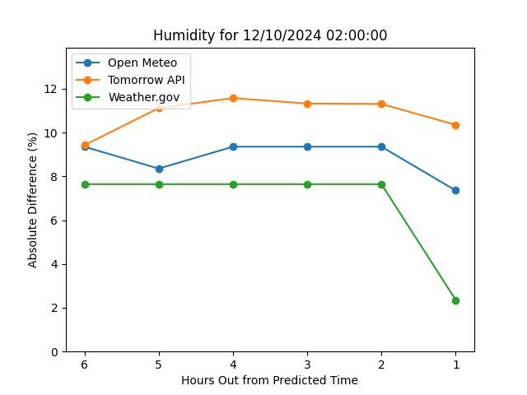
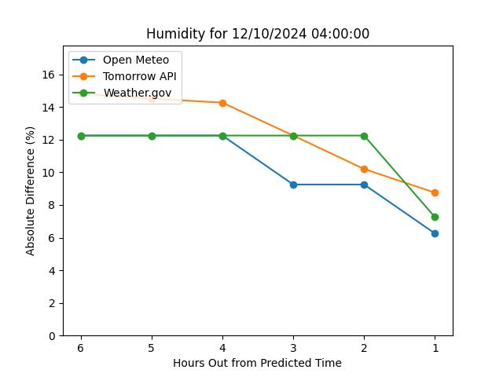
Humidity Prediction Analysis
Actual: 73.3561%
Actual: 78.2538%

Slide 24
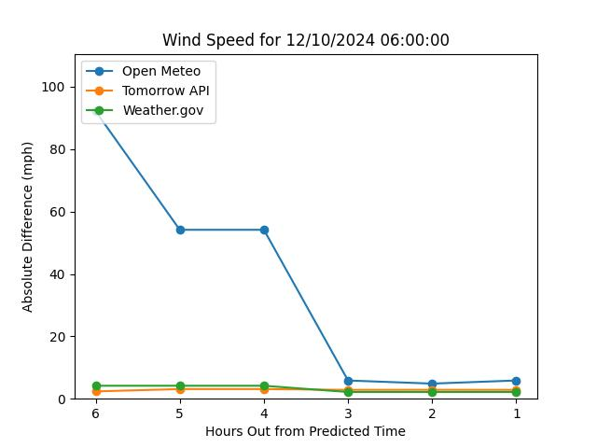
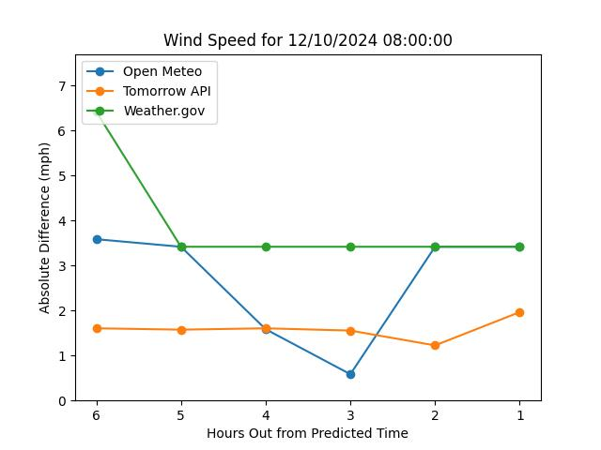
Wind Speed Prediction Analysis
Actual: 7.8454 mph
Actual: 6.5840 mph

Slide 25
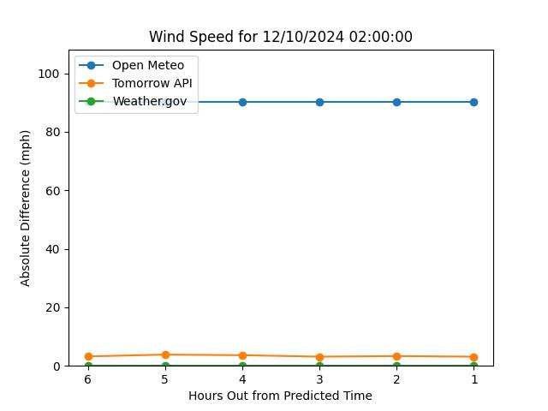
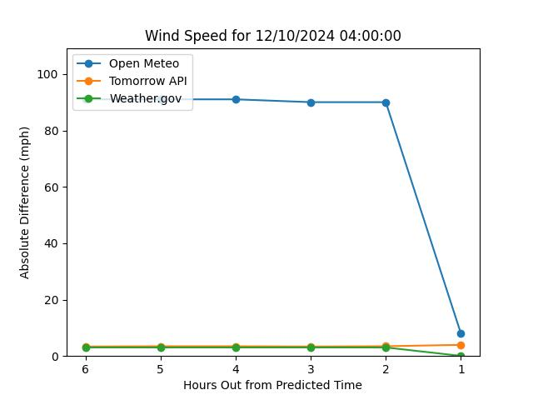
Wind Speed Prediction Analysis
Actual: 9.8502 mph
Actual: 8.9645 mph

Slide 26
Final Data Analysis Remarks
API weather predictions have only moderate accuracy with relation to ARA weather devices
Different API’s are clearly shown to be better at different attributes
Weather.gov for Temperature prediction, etc.
API’s can be unreliable at times
API’s lack location and temporal granularity needed for extremely accurate predictions
API’s predict weather in a relatively large area, using sometimes distance weather station
Most API’s can only make predictions on the hour

Slide 27
Going Forwards

Slide 28
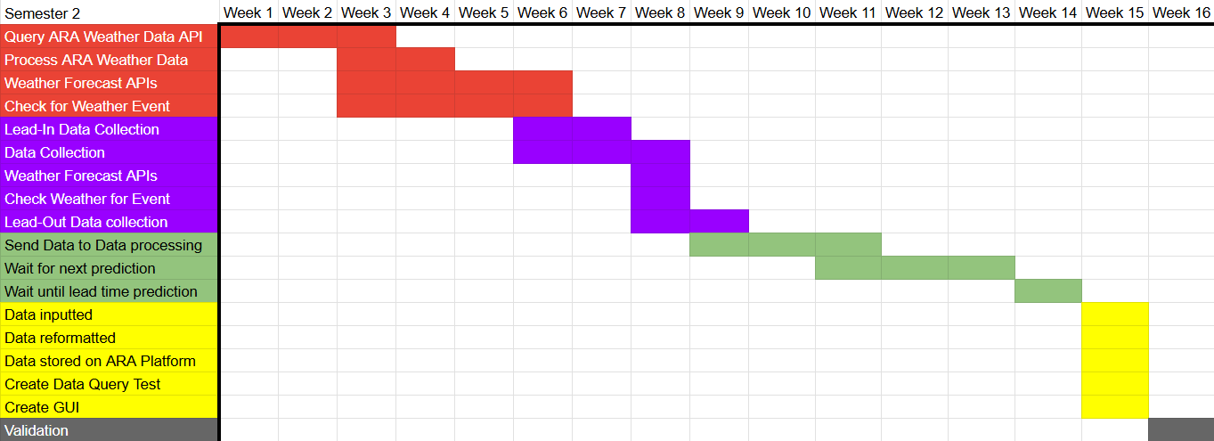
Gantt Chart

Slide 29
Next Steps
Finalize data collection for ARA weather data and ARA wireless signal data
February 14th, 2025
Finalize implementing feedback loop utilizing collected weather data
March 21st, 2025
Finalize data processing module to pair weather and wireless signal data
April 4th, 2025
Finalize in UI for ARA researchers to query datasets
April 18th, 2025

Slide 30
Conclusion

Slide 31
Project Status
Complete:
Weather API Forecasting Prototype
Initial prototype completed October 14th, 2024
Weather API Data Analysis and Forecast Data Visualization
Prototype with visual completed October 31st, 2024
In Progress:
Query ARA Weather and Wireless Data
Running data collection scripts on ARA equipment
Working through a bug where script periodically stops running
Store ARA Weather Data

Slide 32
Summary
Our goal is to develop a weather-triggered telemetry system that measures the performance of wireless technologies deployed on ARA before, during, and after weather events of interest
Our approach is to create a program which uses weather forecast APIs to predict when a weather event will occur and will gather weather and wireless data during those weather events
Researched different weather forecast APIs that could be used in our project to gather prediction data
Created multiple design diagrams to visualize our system and how to begin implementation
Created an initial prototype which gathers API forecast data features over time
Created multiple graphs for each of the APIs, looking at different features and comparing them against the actual weather data to find the accuracy of the predictions

Slide 33
Questions?

